Slide 1
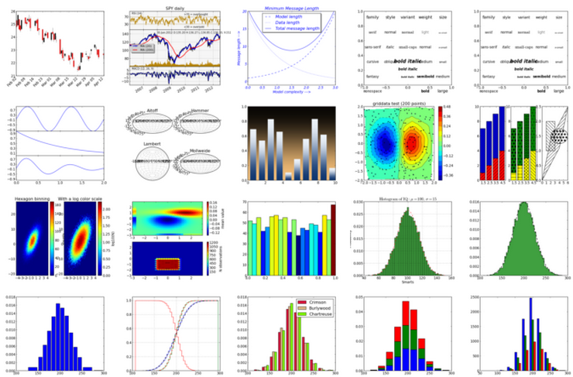

This Photo by Unknown Author is licensed under CC BY-SA

Slide 2
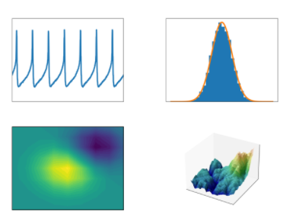
What?
https://matplotlib.org/
Matplotlib is a comprehensive library for creating
static,
animated, and
interactive
visualizations in Python.
Created by John D. Hunter.
Matplotlib is open source, and free.
Notes:
Image:
https://matplotlib.org/

Slide 3

Installation
If installed
import matplotlib
If not
pip install matplotlib
Check version
matplotlib.__version__
General usage: Most of the utilities under pyplot submodule
import matplotlib.pyplot as plt

Slide 4
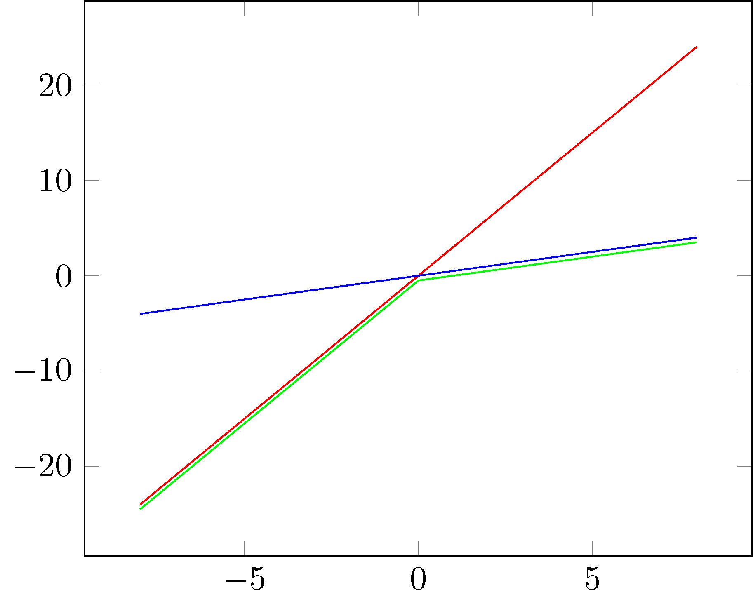
Plot
plot() function: draw points (markers) in a diagram. A line from one point to another
Parameter 1: points on the x-axis.
Parameter 2: points on the y-axis.
x-axis default values [0, 1, 2,…]
This Photo by Unknown Author is licensed under CC BY-SA

Slide 5

Plots and key arguments
Line graph plt.plot() (x_data, y_data)
Scatter plot plt.scatter() (x_data, y_data)
Bar chart plt.bar()(x_locs, bar_heights, width = int)
Histogram plt.hist()(data, bins = int)
Pie chart plt.pie() (data, labels = list)
This Photo by Unknown Author is licensed under CC BY-ND
Notes:
Source: https://cheatography.com/gabriellerab/cheat-sheets/matplotlib-pyplot/

Slide 6

Optional arguments
color = "color“ Change plot color
marker = "symbol" Change marker for line or scatter plot
(".", "x", "|", "o", "^", "v", ">", "<", "*", "d", "h", "D", "s")
markersize = int Change marker size
linewidth = int Change line width for line graph
cmap = colormap Color plot according to a colormap
linestyle = "symbol“ Change style for line plot ("-.", ":", "--", "o")
This Photo by Unknown Author is licensed under CC BY

Slide 7

Labeling functions
plt.title("title") Add a title
plt.xlabel("x axis label") Add a label to the x axis
plt.ylabel("y axis label") Add a label to the y axis
plt.legend(loc = int) Add a legend
plt.xticks(range(min, max, interval)) Modify the x axis tick marks

Slide 8

Key functions
plt.clf() Clear figure
plt.savefig("filename") Save figure (call before plt.show())
plt.show() Show figure
You can put multiple plots in one figure by defining each one before plt.show()
or plt.savefig()
This Photo by Unknown Author is licensed under CC BY-SA

Slide 9

Multiple plots
plt.plot(x_data1, y_data1)
plt.plot(x_data2, y_data2)
plt.plot(x_data3, y_data3)

Slide 10
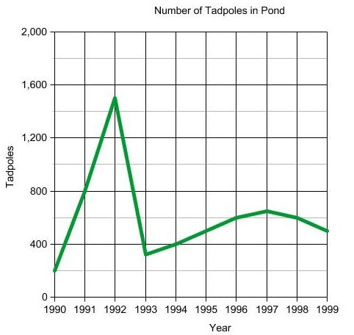
Axis functions
plt.xlim(xmin, xmax) Set the limits for the x axis
plt.ylim(ymin, ymax) Set the limits for the y axis
plt.xscale("scale type") Set scale for the x axis (ex. "log")
plt.yscale("scale type") Set scale for the y axis (ex. "log")
This Photo by Unknown Author is licensed under CC BY-SA-NC

Slide 11
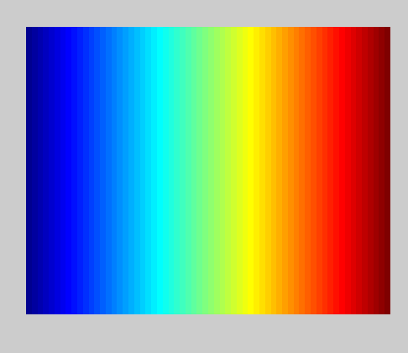
Using colormaps
Choose a colormap and assign to a variable
cm = plt.cm.get_cmap("RdYlBu")
Set the color map in a plot
plt.scatter(x_data, y_data, cmap=cm)
See all colormaps here:
https://matplotlib.org/users/colormaps.html
This Photo by Unknown Author is licensed under CC BY-SA

Slide 12
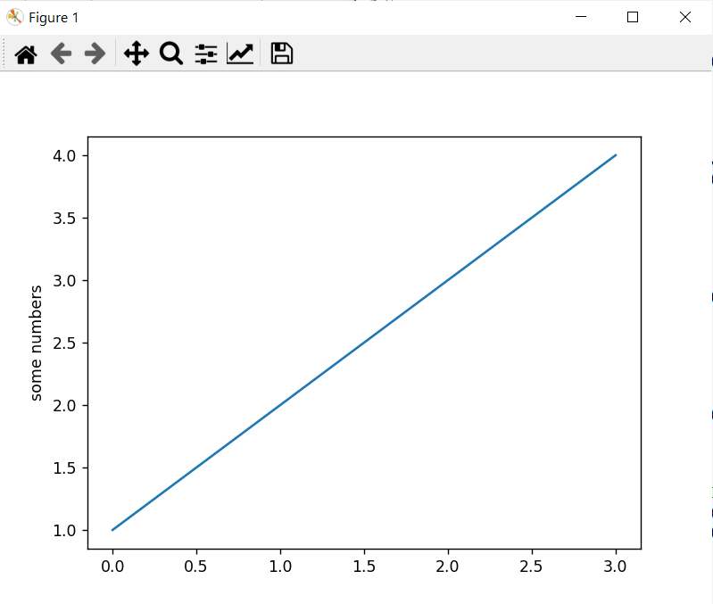

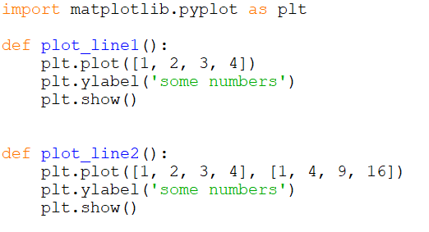
Examples
Notes:
import matplotlib.pyplot as plt
def plot_line1():
plt.plot([1, 2, 3, 4])
plt.ylabel('some numbers')
plt.show()
def plot_line2():
plt.plot([1, 2, 3, 4], [1, 4, 9, 16])
plt.ylabel('some numbers')
plt.show()
def plot_line1_param(y):
plt.plot(y)
plt.ylabel('some numbers')
plt.show()
def plot_line2_param(x, y):
plt.plot(x, y)
plt.ylabel('some numbers')
plt.show()
def plot_line2_param2(x, y):
plt.plot(x, y, marker = 'D', linestyle = '--', color = 'red')
plt.ylabel('some numbers')
plt.xticks(rotation = 90)
plt.show()
def main():
## plot_line1()
## plot_line2()
xL = [1, 2, 3, 4]
yL = [1, 4, 9, 16]
plot_line1_param(xL)
## plot_line2_param(xL, yL)
## plot_line2_param2(xL, yL)
main()

Slide 13
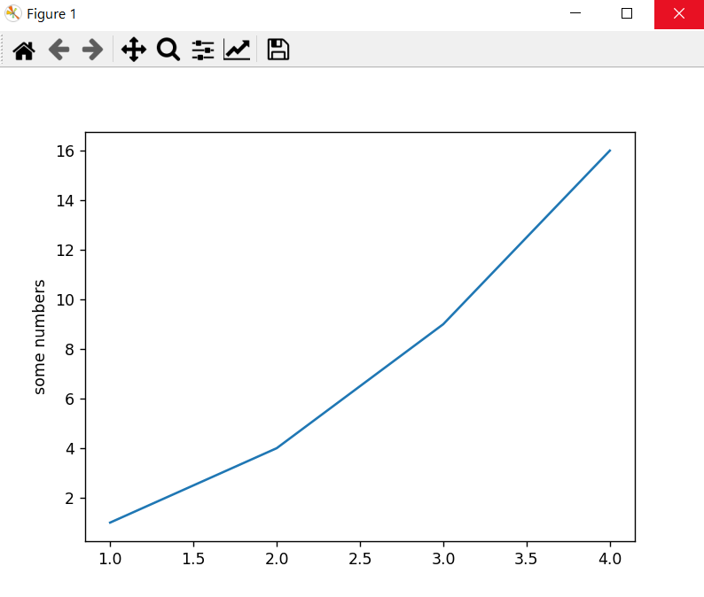
Examples
Notes:
import matplotlib.pyplot as plt
def plot_line1():
plt.plot([1, 2, 3, 4])
plt.ylabel('some numbers')
plt.show()
def plot_line2():
plt.plot([1, 2, 3, 4], [1, 4, 9, 16])
plt.ylabel('some numbers')
plt.show()
def plot_line1_param(y):
plt.plot(y)
plt.ylabel('some numbers')
plt.show()
def plot_line2_param(x, y):
plt.plot(x, y)
plt.ylabel('some numbers')
plt.show()
def plot_line2_param2(x, y):
plt.plot(x, y, marker = 'D', linestyle = '--', color = 'red')
plt.ylabel('some numbers')
plt.xticks(rotation = 90)
plt.show()
def main():
## plot_line1()
## plot_line2()
xL = [1, 2, 3, 4]
yL = [1, 4, 9, 16]
plot_line1_param(xL)
## plot_line2_param(xL, yL)
## plot_line2_param2(xL, yL)
main()

Slide 14
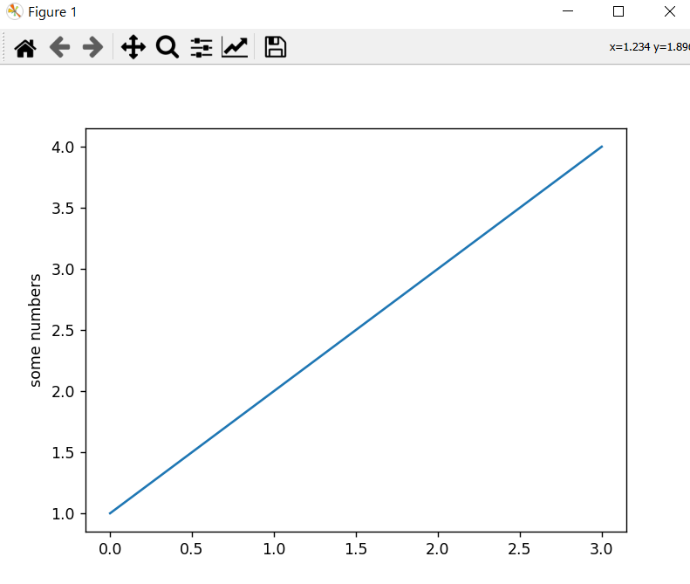
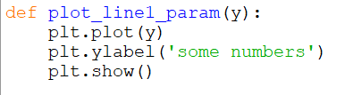
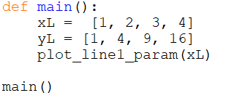
Examples
Notes:
import matplotlib.pyplot as plt
def plot_line1():
plt.plot([1, 2, 3, 4])
plt.ylabel('some numbers')
plt.show()
def plot_line2():
plt.plot([1, 2, 3, 4], [1, 4, 9, 16])
plt.ylabel('some numbers')
plt.show()
def plot_line1_param(y):
plt.plot(y)
plt.ylabel('some numbers')
plt.show()
def plot_line2_param(x, y):
plt.plot(x, y)
plt.ylabel('some numbers')
plt.show()
def plot_line2_param2(x, y):
plt.plot(x, y, marker = 'D', linestyle = '--', color = 'red')
plt.ylabel('some numbers')
plt.xticks(rotation = 90)
plt.show()
def main():
## plot_line1()
## plot_line2()
xL = [1, 2, 3, 4]
yL = [1, 4, 9, 16]
plot_line1_param(xL)
## plot_line2_param(xL, yL)
## plot_line2_param2(xL, yL)
main()

Slide 15
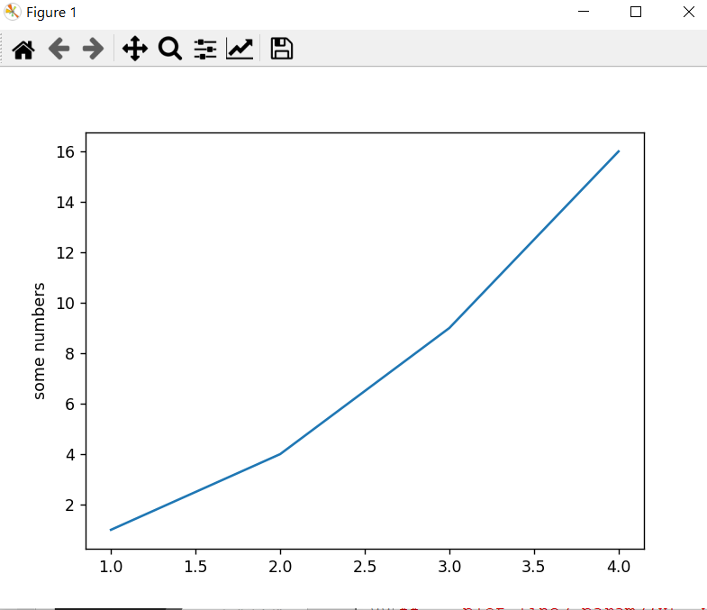
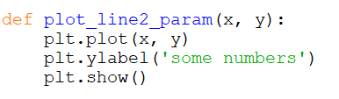
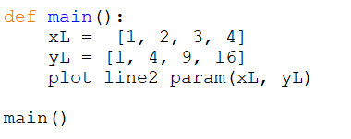
Examples
Notes:
import matplotlib.pyplot as plt
def plot_line1():
plt.plot([1, 2, 3, 4])
plt.ylabel('some numbers')
plt.show()
def plot_line2():
plt.plot([1, 2, 3, 4], [1, 4, 9, 16])
plt.ylabel('some numbers')
plt.show()
def plot_line1_param(y):
plt.plot(y)
plt.ylabel('some numbers')
plt.show()
def plot_line2_param(x, y):
plt.plot(x, y)
plt.ylabel('some numbers')
plt.show()
def plot_line2_param2(x, y):
plt.plot(x, y, marker = 'D', linestyle = '--', color = 'red')
plt.ylabel('some numbers')
plt.xticks(rotation = 90)
plt.show()
def main():
## plot_line1()
## plot_line2()
xL = [1, 2, 3, 4]
yL = [1, 4, 9, 16]
plot_line1_param(xL)
## plot_line2_param(xL, yL)
## plot_line2_param2(xL, yL)
main()

Slide 16
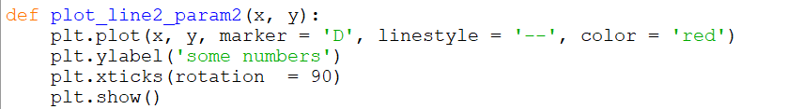
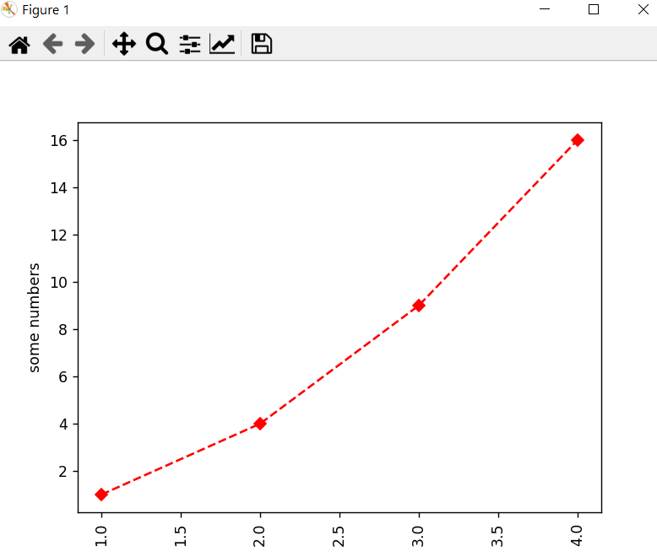
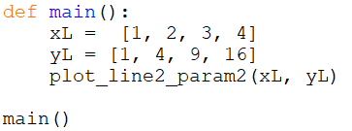
Examples
Notes:
import matplotlib.pyplot as plt
def plot_line1():
plt.plot([1, 2, 3, 4])
plt.ylabel('some numbers')
plt.show()
def plot_line2():
plt.plot([1, 2, 3, 4], [1, 4, 9, 16])
plt.ylabel('some numbers')
plt.show()
def plot_line1_param(y):
plt.plot(y)
plt.ylabel('some numbers')
plt.show()
def plot_line2_param(x, y):
plt.plot(x, y)
plt.ylabel('some numbers')
plt.show()
def plot_line2_param2(x, y):
plt.plot(x, y, marker = 'D', linestyle = '--', color = 'red')
plt.ylabel('some numbers')
plt.xticks(rotation = 90)
plt.show()
def main():
## plot_line1()
## plot_line2()
xL = [1, 2, 3, 4]
yL = [1, 4, 9, 16]
plot_line1_param(xL)
## plot_line2_param(xL, yL)
## plot_line2_param2(xL, yL)
main()

Slide 17
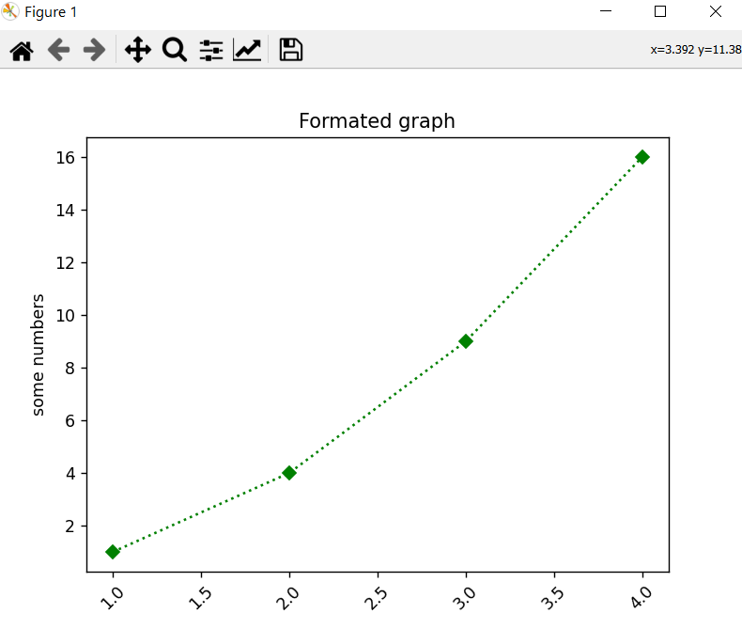
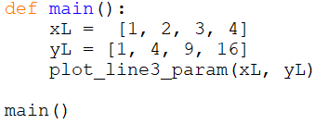
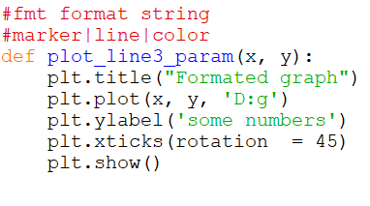
Examples
Notes:
import matplotlib.pyplot as plt
def plot_line1():
plt.plot([1, 2, 3, 4])
plt.ylabel('some numbers')
plt.show()
def plot_line2():
plt.plot([1, 2, 3, 4], [1, 4, 9, 16])
plt.ylabel('some numbers')
plt.show()
def plot_line1_param(y):
plt.plot(y)
plt.ylabel('some numbers')
plt.show()
def plot_line2_param(x, y):
plt.plot(x, y)
plt.ylabel('some numbers')
plt.show()
def plot_line2_param2(x, y):
plt.plot(x, y, marker = 'D', linestyle = '--', color = 'red')
plt.ylabel('some numbers')
plt.xticks(rotation = 90)
plt.show()
#fmt format string
#marker|line|color
def plot_line3_param(x, y):
plt.title("Formated graph")
plt.plot(x, y, 'D:g')
plt.ylabel('some numbers')
plt.xticks(rotation = 45)
plt.show()
def main():
xL = [1, 2, 3, 4]
yL = [1, 4, 9, 16]
plot_line3_param(xL, yL)
main()

Slide 18
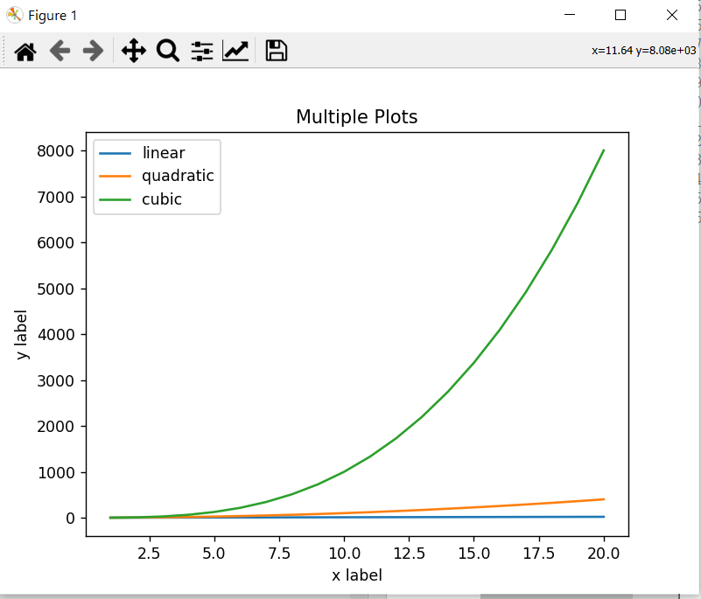
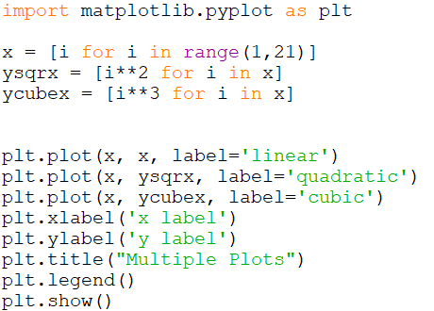
Multiple Plots
Notes:
import matplotlib.pyplot as plt
x = [i for i in range(1,21)]
ysqrx = [i**2 for i in x]
ycubex = [i**3 for i in x]
plt.plot(x, x, label='linear')
plt.plot(x, ysqrx, label='quadratic')
plt.plot(x, ycubex, label='cubic')
plt.xlabel('x label')
plt.ylabel('y label')
plt.title("Multiple Plots")
plt.legend()
plt.show()

Slide 19
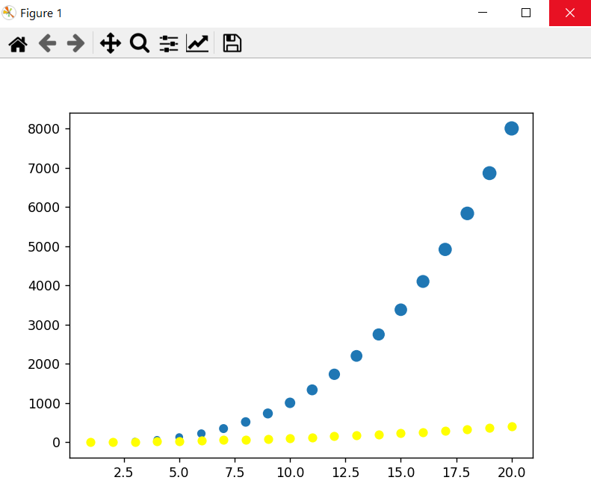
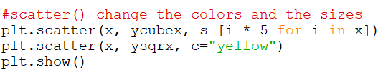
Scatter plot plt.scatter() (x_data, y_data)
Notes:
#scatter() change the colors and the sizes
plt.scatter(x, ycubex, s=[i * 5 for i in x])
plt.scatter(x, ysqrx, c="yellow")
plt.show()

Slide 20

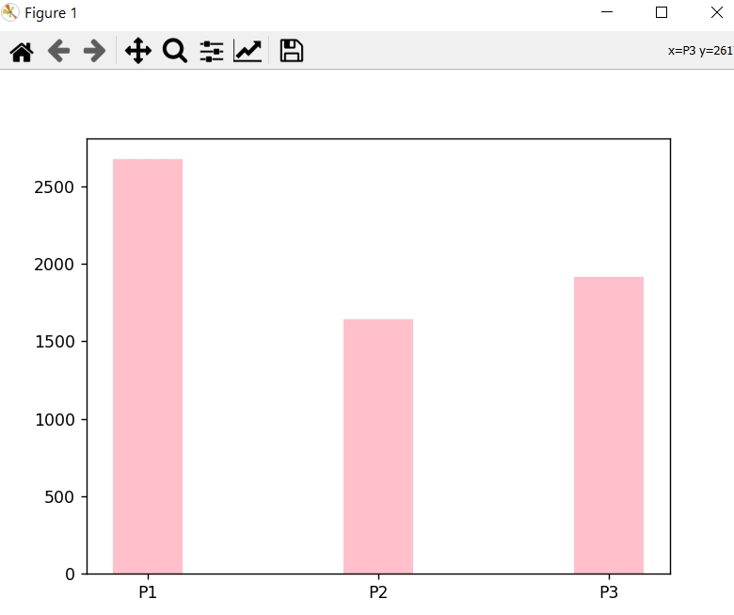
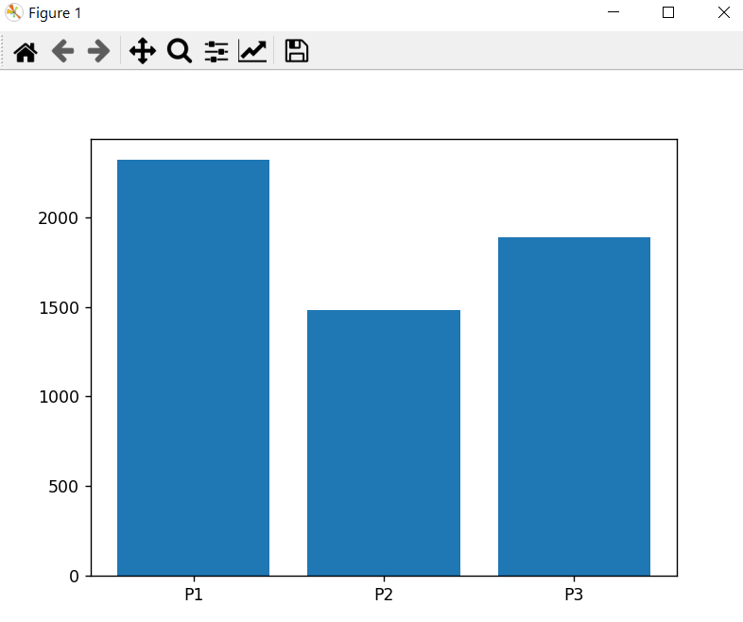
Bar chart plt.bar()(x_locs, bar_heights, width = int)
Notes:
parties = ["P" + str(i) for i in range(1,4)]
votes = [random.randint(1000, 3000) for i in parties]
plt.bar(parties, votes)
plt.show()
plt.bar(parties, votes, width=0.3, color='pink')
plt.show()

Slide 21
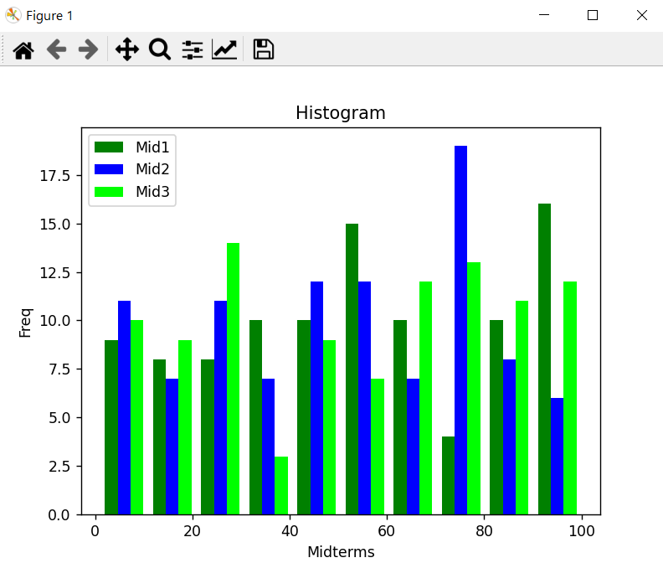
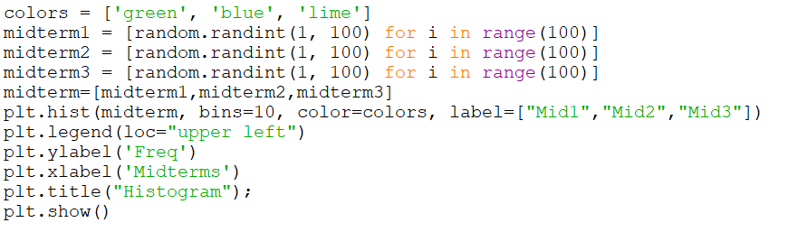
Histogram plt.hist()(data, bins = int)
Notes:
colors = ['green', 'blue', 'lime']
midterm1 = [random.randint(1, 100) for i in range(100)]
midterm2 = [random.randint(1, 100) for i in range(100)]
midterm3 = [random.randint(1, 100) for i in range(100)]
midterm=[midterm1,midterm2,midterm3]
plt.hist(midterm, bins=10, color=colors, label=["Mid1","Mid2","Mid3"])
plt.legend(loc="upper left")
plt.ylabel('Freq')
plt.xlabel('Midterms')
plt.title("Histogram");
plt.show()
Note:
bins int or sequence or str, default: rcParams["hist.bins"] (default: 10)
If bins is an integer, it defines the number of equal-width bins in the range.
If bins is a sequence, it defines the bin edges, including the left edge of the first bin and the right edge of the last bin; in this case, bins may be unequally spaced. All but the last (righthand-most) bin is half-open. In other words, if bins is:
[1, 2, 3, 4]
then the first bin is [1, 2) (including 1, but excluding 2) and the second [2, 3). The last bin, however, is [3, 4], which includes 4.
If bins is a string, it is one of the binning strategies supported by numpy.histogram_bin_edges: 'auto', 'fd', 'doane', 'scott', 'stone', 'rice', 'sturges', or 'sqrt'.

Slide 22
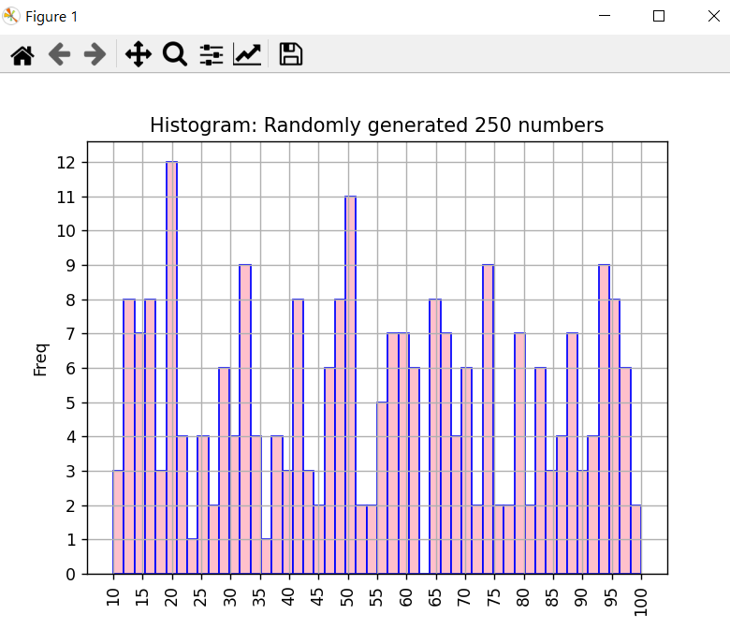
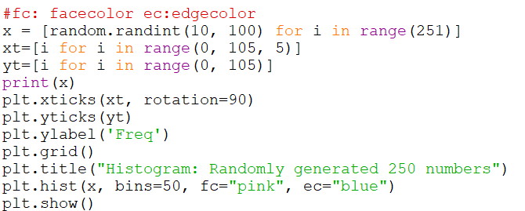
Histogram plt.hist()(data, bins = int)
Notes:
#fc: facecolor ec:edgecolor
x = [random.randint(10, 100) for i in range(251)]
xt=[i for i in range(0, 105, 5)]
yt=[i for i in range(0, 105)]
print(x)
plt.xticks(xt, rotation=90)
plt.yticks(yt)
plt.ylabel('Freq')
plt.grid()
plt.title("Histogram: Randomly generated 250 numbers")
plt.hist(x, bins=50, fc="pink", ec="blue")
plt.show()

Slide 23
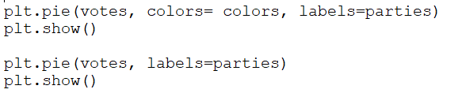
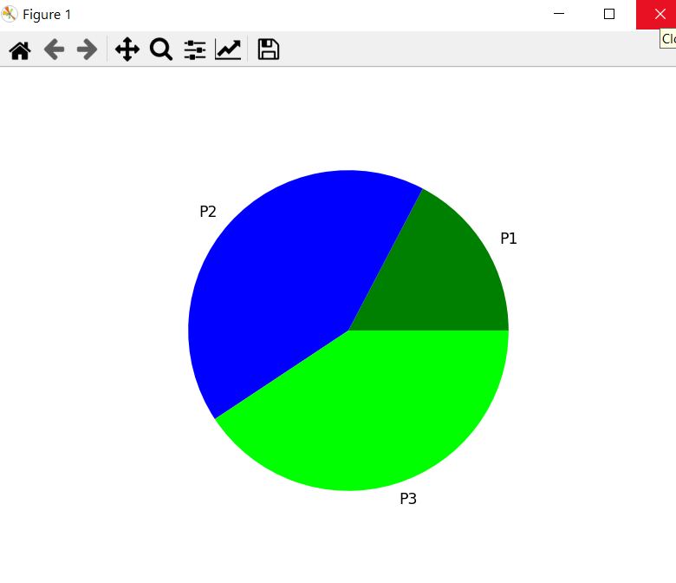
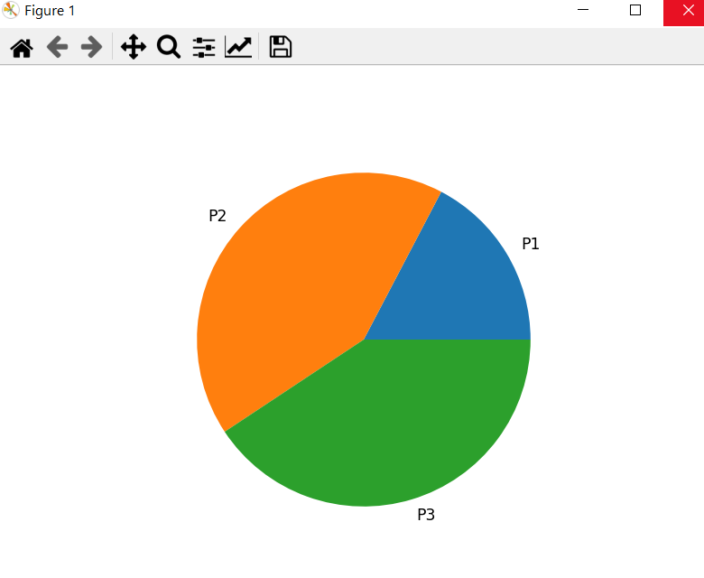
Pie chart plt.pie() (data, labels = list)

